Slide 1


SECURE SOFTWARE DEVELOPMENT (SSD)
Diploma in CSF
Academic Year (AY) 22/23 – Semester 3 (April `22)
Week 6
Secure software Design – Part 2
Last Updated: 21/05/2022

Slide 2
Contents
Key Secure Design Principles
Authentication Design
Recap – Design CIA
Mission 6.1: Razor Pages Security III

Slide 3
Recap – Design CIA
Confidentiality
Integrity
Availability
Symmetric Key Cryptosystem (SKC)
Asymmetric Key Cryptosystem (ASKC)
Combining SKE & ASKE
Hashing
Digital Signature
Code Signing
Referential Integrity
Resource Locking
Failover
Replication
Scalability

Slide 4
Authentication Design
Authentication Design
Multi-Factor Authentication
Single Sign-On (SSO)
Federation

Slide 5

Multi-Factor Authentication
Multi-factor or the use of more than one factor to authenticate a principal (user or resource), therefore provides heightened security and is recommended.
Copyright @ https://www.youtube.com/watch?v=0mvCeNsTa1g

Slide 6

Multi-Factor Authentication
For example, validating and verifying one’s fingerprint (something you are) in conjunction with a token (something you have) and pin code (something you know) before granting access provides more defense in depth than merely using a username and password (something you know).
Copyright @ https://www.youtube.com/watch?v=07mRDyydCNY

Slide 7
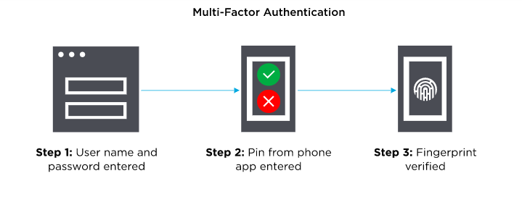
Multi-Factor Authentication
Things you know (knowledge),
Things you have (possession)
Things you are (inherence),

Slide 8
Single Sign On (SSO)
SSO, wherein the principal’s asserted identity is verified once and the verified credentials are passed on to other systems or applications, usually using tokens, then it is crucial to factor into the design of the software both the performance impact and its security.
SSO simplifies credential management and improves user experiences and performance because the principal’s credential is verified only once.

Slide 9
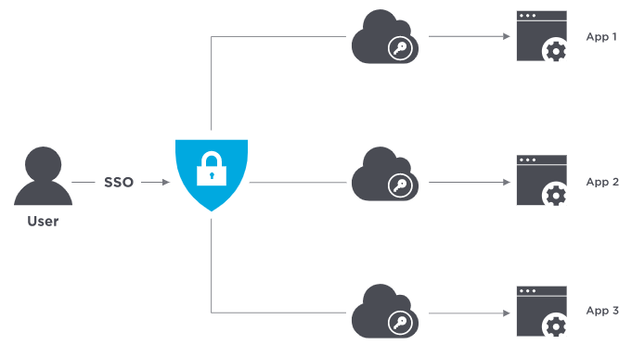
Benefits of Single Sign On (SSO)
SSO provides ability for employees to log in just one time with one set of credentials to get access to all corporate apps, websites, and data.
Greater security and compliance.
Improved usability and employee satisfaction.
Lower IT costs.

Slide 10
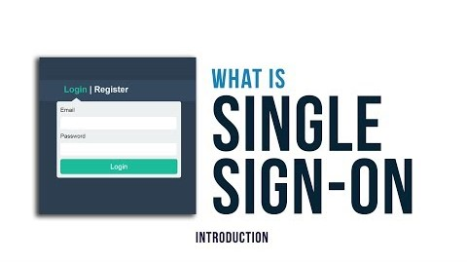
Danger of Single Sign On (SSO)
Improper design of SSO can result in security breaches that have colossal consequences. A breach at any point in the application flow can lead to total compromise
Copyright @ https://www.youtube.com/watch?v=kRGPKh3NgHU

Slide 11
Federation
Federation extends SSO across enterprises.
In a federated system, an individual can log into one site and access services at another affiliated site without having to log in each time or re-establish an identity.

Slide 12
Activity 1: SSO or Federation?
Statement 1
Ability to authenticate (prove identity) once, and then be able to access different authorized resources without needing to authenticate again
Statement 2
Trusted mechanism of verifying and transferring identity between service provider (which serves resource you are trying to access) and identity provider (which verified and asserted your identity)
Identify the authentication type for the statements provided above.
Statement 1: _____SSO_______
Statement 2: _____Federation_______

Slide 13
Key Secure Design Principles
Least Privilege
Separation of duties
Defense-in-Depth
Fail Safe
Economy of Mechanism
Complete Mediation
Open Design
Least Common Mechanism
Psychological Acceptability
Leveraging Existing Components
Read Security Design Principles
Source: Official (ISC)² CSSLP CBK – 2nd Edition - Mano Paul

Slide 14
Key Secure Design Principles
Design Principles | Examples
Least Privilege | Use of accounts with non-administrative abilities, eg; instead of sysadmin account, use datareader account to execute database commands.
Separation of duties | Programmer should not be allow to review his/her own code.
Defense-in-Depth | Disallowing active scripting in conjunction with output encoding to defend against XSS attack.
Fail Safe | Account lockout mechanism
Economy of Mechanism | Single Sign On (SSO) illustrates simplification of user authentication. Keep it simple.

Slide 15
Key Secure Design Principles
Design Principles | Examples
Complete Mediation | Access requests need to be mediated each time, every time, so that authority is not circumvented in subsequent requests.
Open Design | Kerckhoff’s principle where all information about crypto system is public knowledge except the key.
Least Common Mechanism | Mechanisms common to more than one user or processes, should not be used.
Psychological Acceptability | Easy to use interface that process transaction transparently.
Leveraging Existing Components | Reuse of tested and proven, existing libraries and common components.

Slide 16
Activity 2: Design Principle
To allow for rapid recovery to the state of normal operations, when unexpected events occur is the security design principle of ____________
Use of test harnesses promotes the secure design principle of ____________
Nicole is part of the ‘author’ role as well as she is included in the ‘approver’ role, allowing her to approve her own articles. This violates the secure design principle of ____________
Notes:
Use of test harnesses promotes the secure design principle of ……………………….(leveraging existing components)
Rationale: Once harness is up, it can be used in many test case scenarios

Slide 17
Open-Ended Question
Qn 1: Explain in your own words, how does psychological acceptability principle help in the design of a secure software?
Attempt the open-ended questions above.
Submit your answers in Teams group.
SSD-AY2223-xxx-Pxx → Week 6
Use “Conversations” tab under “SSD-AY2223-xxx-Pxx → Week 6” to discuss within your class group.

Slide 18
Mission 6.1: Razor Pages Security III (Individual)
Attempt the Razor Pages Security III practical
Click on “Files” tab and download the “Razor Pages Security 3 - Security Countermeasures.pdf”
Submit detailed screenshots of your completed page in PoliteMall.
The screenshots must show the browser’s “Address Bar” to verify the application is running in your laptop.
Deadline: by End of Week 7
Penalty for late submission
If you got any issues or suggestions regarding Mission 6.1
Use “Conversations” tab under “SSD-AY2223-xxx-Pxx → Week 6” to discuss within your class group.
Tutors would also monitor these “Conversations”.

